Slide 1
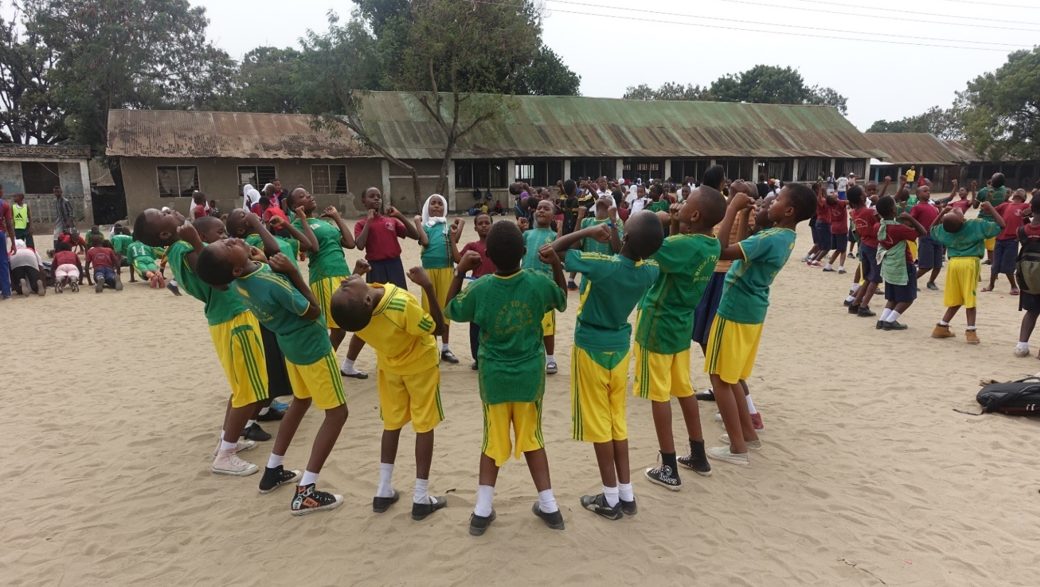


Slide 2
Play for Learning Outcomes.

Slide 3
  Purpose
Participate in a Play-Based Learning activity using a modified game to develop literacy skills.
Create RCA discussion questions for developing core competencies and language skills.

Slide 4
1. Developing Literacy Skills through Play
Building the Pyramid Game

Slide 5
1. Developing Literacy Skills through Play
Build-A-Word Game

Slide 6
1. Developing Literacy Skills through Play
Modifying Games
Remember “STEP” when Modifying Games
When modifying games you can modify the:
Size or Shape of the playing surface – for example, make it smaller or larger, circular or square
Tasks or rules of the game – for example, instead of having to count to ten to become “unfrozen” in a tag game, students have to solve a spelling challenge
Equipment – for example, instead of collecting beanbags, students collect cards with numbers on them to use for addition and subtraction tasks
People playing the game – for example, students work in smaller teams to accomplish the task
Most importantly: BE CREATIVE

Slide 7
1. Developing Literacy Skills through Play
Tip 1: Remember that effective questions are open-ended, specific, and focused on your curriculum objective.
Tip 2: For the Connect question, you can connect to both male and female students’ lives and experiences. You can also connect to their previous knowledge. For example, you might ask: “Where have you seen this before? What strategies have you used in the past
Tip 3: For the Apply question, encourage male and female students to think about their life in the classroom but also beyond the classroom. How could they apply their new knowledge to a future learning activity? Additionally, the Apply question does not necessarily need to be a question. You may give students a small task or piece of homework to help them to apply their knowledge.

Slide 8
Using 2 Sets of RCA
  Teaching subject content by using Play-Based Learning complete with RCA discussion questions for both core competencies and subject content has the following benefits:”
    Having two sets of RCA discussion questions help teachers build their own skills in the methodology itself. Over time teachers will be able to merge the questions on subject and core competency seamlessly as if they are only having a conversation with their students.
    Having two sets of RCA discussion questions help teachers accomplish multiple learning – one for subject and the other for the core competencies found in the curriculum.
    Integrating core competency discussions in subject lessons help students develop ‘conscious competence.

Slide 9
Using 2 Sets of RCA
  Remember that in the initial stages of modifying games to teach subject content, teachers will naturally focus on the Learning Objective related to that content alone. This does not mean that the core competencies disappear from the game. Children will still gain core competency benefits from the game, even if the focus is on academic content. In fact the core competencies in the game can enhance their curriculum learning. Regardless of the curriculum focus, children will have to cooperate, work together, think critically, solve problems, concentrate

Slide 10
Using 2 Sets of RCA
Build-A-Word
RCA Discussion Question for Subject Matter
Reflect: Which words were the most difficult to spell? Which were the easiest?
Connect: Which everyday word do you or your friends usually have a hard time spelling correctly?
Apply: Which difficult word would you like to spell when you get back home?

Slide 11
Using 2 Sets of RCA
Build-A-Word
RCA Discussion Question for Core Competency on Cooperation and Collaboration (CC)
Reflect: What did the members of your team do so you can get the spelling correctly?
Connect: How do you figure out how to spell a word? Who helps you at home when you have trouble spelling?
Apply: Who can help you practice the words that are difficult for you? Who can you help today to spell words correctly?

Slide 12
Using 2 Sets of RCA
Determining the 2 Sets of RCA Questions

Slide 13
Questions and Answers

Slide 14
Thank you!

